Slide 1
Sender Pays
Geoff Huston AM
Chief Scientist, APNIC

Slide 2
Why is “Sender Pays” an issue at all?
Because its easier to blame <Google | Netflix |*> for the weaknesses in a poor <network design | business model | retail offering | *> than actually addressing the underlying changes in the carriage business model!
Which leads to the obvious question:
Why install a high speed broadband last mile access infrastructure if the interior of the carriage service was never capable of being used to its full extent?

Slide 3
The tension between carriage and content has a long history
Over the years each side has asserted its primacy in the relationship
Carriage says that content’s customers lie on the other side of the carriage service – without carriage there would be no content customers
Content says that there is no point to the carriage service without content – without content there would be no carriage customers

Slide 4
Carriage / Content settlements
The user takes out a broadband subscription from a local Carriage Provider (CP)
The user takes out a streaming video subscription from a video streamer via a CDN
The user streams a video
Option 1 – Settlement Free
The CP and the streamer are both being funded by the user and there is no settlement payment between the CP and the Streamer
Option 2 – Content pays for Carriage
The streamer also pays for carriage across the CP network
Option 3 – Carriage pays for Content
The CP pays the streamer on behalf of its users and bundles the streaming service into its retail service
0
0

Slide 5
The tension between carriage and content has a long history
Over the years we’ve seen content services gather value and primacy, while the carriage service becomes more of an undistinguished basic commodity
But that does not mean that the carriage folk are willing to quietly accept the inevitable…

Slide 6
The Net Neutrality debate
Interview with SBC CEO Edward Whitacre, Business Week Online, 7 November 2005 How concerned are you about Internet upstarts like Google, MSN, Vonage, and others?
How do you think they're going to get to customers? Through a broadband pipe. Cable companies have them. We have them. Now what they would like to do is use my pipes free, but I ain't going to let them do that because we have spent this capital and we have to have a return on it. So there's going to have to be some mechanism for these people who use these pipes to pay for the portion they're using. Why should they be allowed to use my pipes? The Internet can't be free in that sense, because we and the cable companies have made an investment and for a Google or Yahoo! or Vonage or anybody to expect to use these pipes [for] free is nuts! "

Slide 7
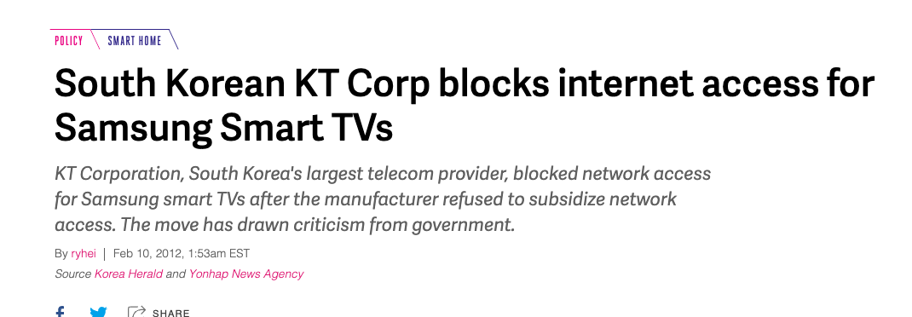
Carriage Blocking

Slide 8
Enter content providers as carriage providers…
The content sector’s response to this tension is to bypass the established carriage offerings and to build their own carriage services where feasible
These are the Content Delivery Networks (CDN) that package content services with a dedicated delivery networks

Slide 9
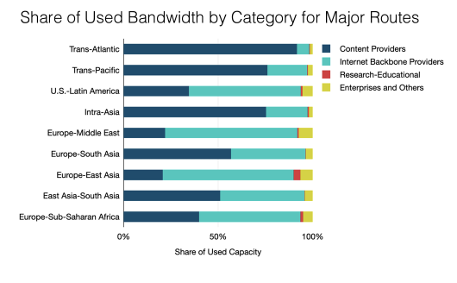
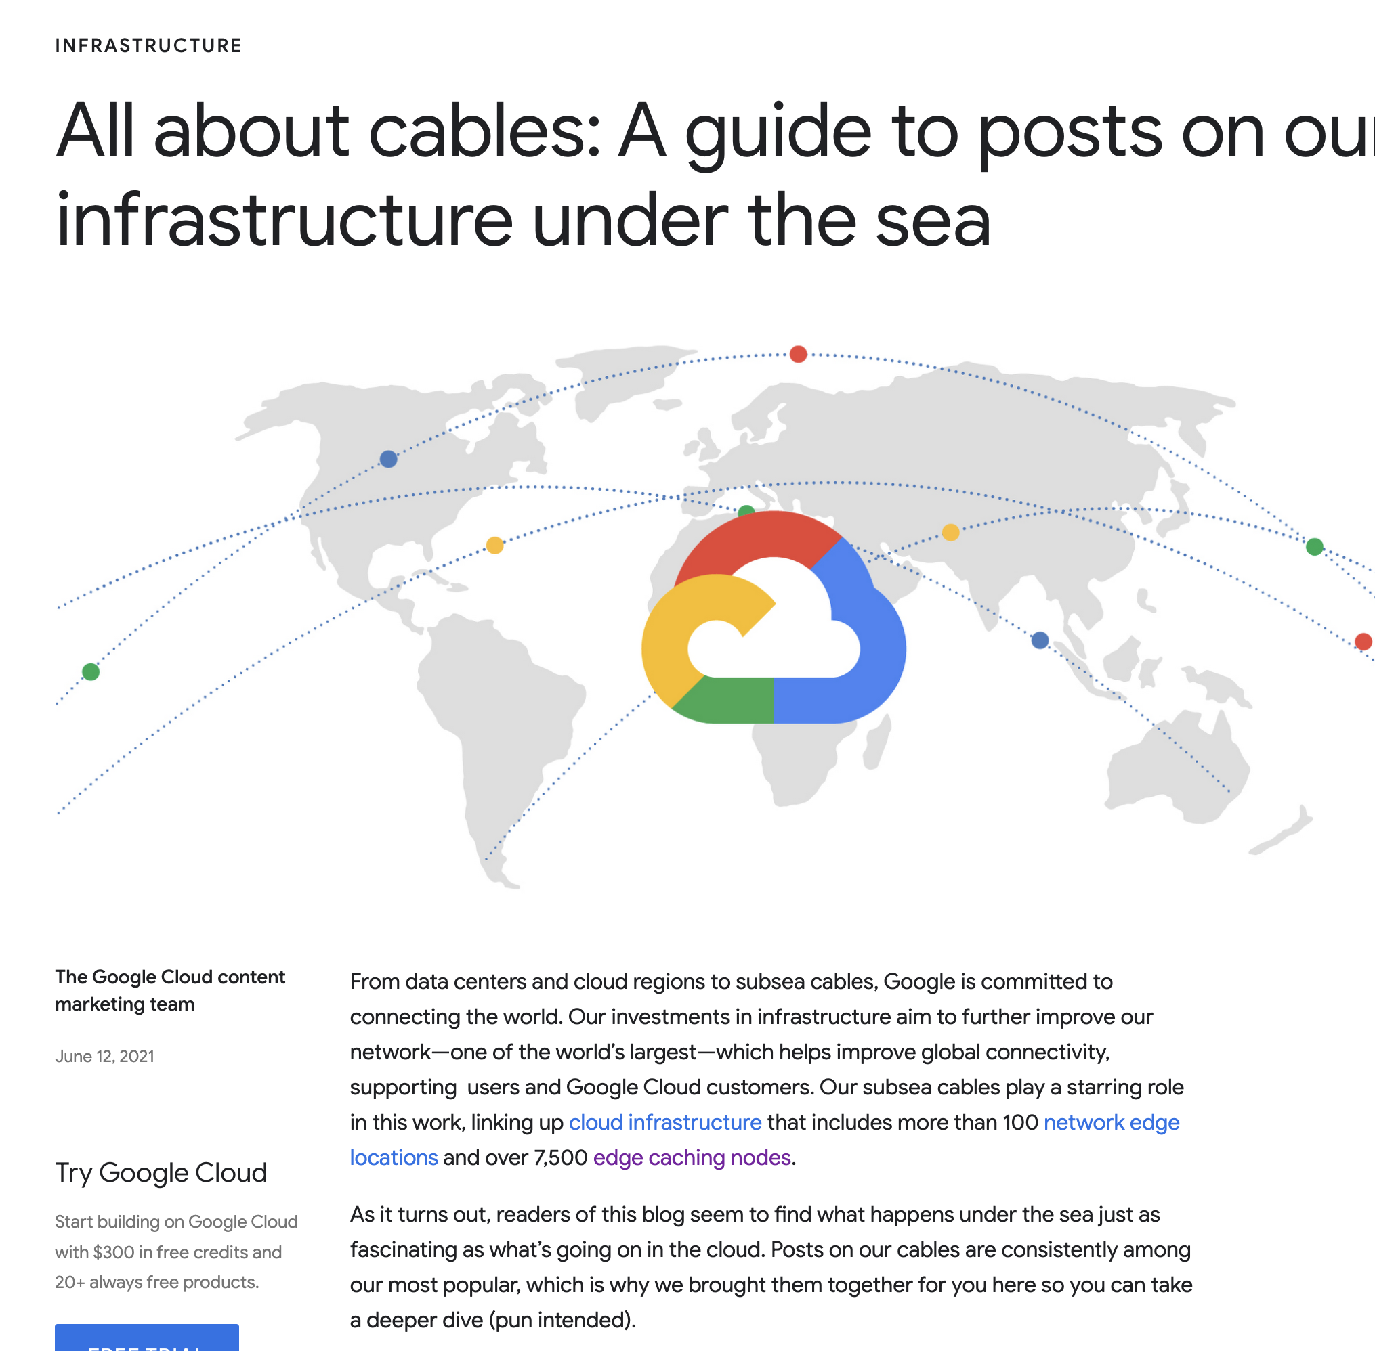
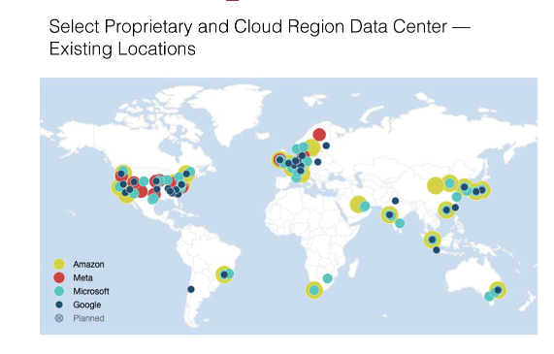
Content as Carriers
Google’s Cable activity
Telegeography Analysis

Slide 10
So, what’s the real problem for the carriage industry?
Money!

Slide 11

The Reality
Carriage operators are losing control of pricing, services, technology, content and customers
CDNs and Over-The-Top services using IP end-to-end impact every aspect of the telco business model
Almost the only residual asset left for the traditional carriage provider is the local access loop
And that’s the subject of intense pressure

Slide 12

Content’s Move
Content is now exploiting encryption to hide everything from the carrier
Encrypt the content (TLS)
Encrypt the meta-data of the content (ECH)
Encrypt the DNS (DoT, DoQ, DoH)
Encrypt the transport protocol (QUIC)
Encrypt the end points from each other (Oblivious services)
This pushes the carriage provider further into a commodity role, dealing in undistinguished opaque traffic

Slide 13
What are we learning?
“Sender Pays” does not improve the efficiency of the carriage infrastructure, nor does it benefit consumers
Carriage is no longer an inescapable monopoly - massively replicated content can be used as a substitute for many public carriage service elements
Structural cross-subsidies and poor regulatory responses weaken the longer-term incentives for efficient infrastructure investment

Slide 14
Full Presentation Pack

Slide 15
Why is “Sender Pays” an issue at all?
There are many commodity utility enterprises in today’s world
water, electricity, transportation,…
Why is network infrastructure provision any different?

Slide 16
Why is “Sender Pays” an issue at all?
Because its easier to blame <Google | Netflix |*> for the weaknesses in a poor <network design | business model | retail offering | *> than actually addressing the underlying changes in the carriage business model!
Which leads to the obvious question:
Why install a high speed broadband last mile access infrastructure at all if the interior of the carriage service was never capable of being used to its full extent?

Slide 17

Because …
It wasn’t always this way for the telco business model. They used to enjoy:
Complete control of the network
Complete control of the service
Complete control of the customer

Slide 18
The Converged Telco Utopia
A small number of vertically integrated “full” service providers leveraging their underlying infrastructure investment into a high yield, high margin service delivery retail system using a single network platform for comprehensive service delivery where everyone, including content providers, pay for carriage
Low cost, high value, strong service control, fantastic margins!

Slide 19
Wouldn’t it be wonderful…
If you could bill the end user for the value of delivered services rather than just the packets
Customers paid you for value-added service solutions, rather than the marginal cost of packet delivery
Content Service Providers paid you for access to your customers

Slide 20
How did we get to here?

Slide 21

Inter-Provider Settlements for letter delivery
A user buys a postage stamp from the local post office
A user writes a letter
A user affixes a stamp to the letter in order to prepay for the entire delivery process
The local post operator passes the letter to the destination post operator
The local post operator pays the destination post operator a termination delivery fee as an inter-provider settlement
The letter is delivered at no cost to the receiver

Slide 22
Sender Pays
Retail Model: You send a letter, then you pay the entire cost of delivery
Inter-provider Model: Sending PO pays the Delivery PO to complete the letter delivery
This model is stable for bilateral connections, less so for multi-party transactions with transit intermediaries
In a stable state the retail model matches the inter-provider settlement model
When they deviate it creates the opportunity for arbitrage between providers, which becomes unstable

Slide 23

Inter-Provider Settlements for telephone calls
A user dials a phone number using a local telephone company
The local phone company creates a connection to the destination phone company
The destination phone company completes the call request
The call is answered at no cost to the receiver
The call is metered by the local phone company and the caller is charged for the entire cost of the call
The call is metered by the terminating phone company and a termination settlement fee is charged to the local phone company as an inter-provider settlement

Slide 24
Caller Pays
Retail Model: You call, then you pay for the entire costs of the call
Inter-provider Model: Call Initiator pays the Call terminator to complete the call
This model is stable for bilateral connections, less so for multi-party transactions with transit intermediaries
In a stable state the retail model matches the inter-provider settlement model
When they deviate it creates the opportunity for arbitrage between providers, which becomes unstable

Slide 25
Enter the Internet
What’s a “call”?
Users pay a fee for “access”
There may be volume and/or access speed fee components in the fee, but this is about tiered access fees to cover more market segments
When a packet is passed from one provider to another who pays?
We arrived at a simple outcome of a market-based mechanism
Either the parties agree to enter into a single customer/provider relationship for ALL data traffic between the two providers
Or the parties agree to exchange traffic between them without payment (Sender Keep All)
Or there is no interconnection at all

Slide 26
The Tradition
Network Neutrality and Common Carrier Roles:
The Carrier’s network is strictly neutral with respect to carried content
The network does not prevent the carriage of data and services
The network does not bias its response or tariffs in favour of certain services and service providers
The network is strictly neutral with respect to competing service providers
Everybody pays to use the carriage network
Carriers settle between themselves

Slide 27
The Net Neutrality debate
Interview with SBC CEO Edward Whitacre, Business Week Online, 7 November 2005 How concerned are you about Internet upstarts like Google, MSN, Vonage, and others?
How do you think they're going to get to customers? Through a broadband pipe. Cable companies have them. We have them. Now what they would like to do is use my pipes free, but I ain't going to let them do that because we have spent this capital and we have to have a return on it. So there's going to have to be some mechanism for these people who use these pipes to pay for the portion they're using. Why should they be allowed to use my pipes? The Internet can't be free in that sense, because we and the cable companies have made an investment and for a Google or Yahoo! or Vonage or anybody to expect to use these pipes [for] free is nuts! "

Slide 28
Content Settlements
The user takes out a broadband subscription from a local Carriage Provider (CP)
The user takes out a streaming video subscription from a video streamer via a CDN
The user streams a video
Option 1 – Settlement Free
The CP and the streamer are both being funded by the user and there is no settlement payment between the CP and the Streamer
Option 2 – Content pays for Carriage
The streamer also pays for carriage across the CP network
Option 3 – Carriage pays for Content
The CP pays the streamer on behalf of its users and bundles the streaming service into its retail service
0
0

Slide 29
Content vs Carriage
Round 1:
Content pays for Carriage
The carriage providers provided the connection between customers and content providers
Customers paid the carriage access service provider to access the services
Content providers paid the carriage service provider to access the customers
MSN, numerous Portal Services

Slide 30
Content vs Carriage
Round 1:
Content pays for Carriage
The carriage providers provided the connection between customers and content providers
Customers paid the carriage access service provider to access the services
Content providers paid the carriage service provider to access the customers
MSN, numerous Portal Services
Failure!

Slide 31
Content vs Carriage
Round 2:
Carriage pays for Content
Content providers were failing in the initial rounds of pay-per-view models of content distribution
Content providers mounted the case that the only reason why customers paid access providers for Internet access was their uniquely compelling content, generated at great expense
Ergo: Access providers owed content providers a share of the access fees if they wanted to continue to have access to their content

Slide 32
Content vs Carriage
Round 2:
Carriage pays for Content
Content providers were failing in the initial rounds of pay-per-view models of content distribution
Content providers mounted the case that the only reason why customers paid access providers for Internet access was their uniquely compelling content, generated at great expense
Ergo: Access providers owed content providers a share of the access fees if they wanted to continue to have access to their content
Failure!

Slide 33
Content vs Carriage
Round 3:
Carriage owns Content
Carriage Access Providers attempted to generate their own proprietary content as a retail differentiator
Content was only accessible within their access domain
Carriage enterprises purchased content generators
Remember Telstra’s tilt at Fairfax? Verizon purchasing Yahoo?

Slide 34
Content vs Carriage
Round 3:
Carriage owns Content
Carriage Access Providers attempted to generate their own proprietary content as a retail differentiator
Content was only accessible within their access domain
Carriage enterprises purchased content generators
Remember Telstra’s tilt at Fairfax? Verizon purchasing Yahoo?
Failure!

Slide 35
Content vs Carriage
Round 4:
Content owes Carriage
Penetration of high speed broadband and a new round of software platforms enables a new generation of content providers
Content engages with the advertising industry with advertiser-funded content and services
The carriage service provider gets squeezed out of the content model completely and is relegated to undifferentiated carriage pipe provider
The carriage provider heads off to the regulator to seek relief from the onerous common carrier provisions in order to leverage a position against content providers

Slide 36
Content vs Carriage
Round 4:
Content owes Carriage
Penetration of high speed broadband and a new round of software platforms enables a new generation of content providers
Content engages with the advertising industry with advertiser-funded content and services
The carriage service provider gets squeezed out of the content model completely and is relegated to undifferentiated carriage pipe provider
The carriage provider heads off to the regulator to seek relief from the onerous common carrier provisions in order to leverage a position against content providers
This will fail too!

Slide 37
Content vs Carriage
Round 5:
The Dominance of Content
The content service industry has aggregated to the extent that they can operate their own carriage services at lower cost and greater efficiency through dedicated Content Distribution Networks
All that’s left to the old public carriage industry are a collection of last mile access networks

Slide 38
Carriage Reality
Deregulation, intense competition, branching role specialization at every level
Resulting in
many parallel service delivery networks, many network operators,
industry-wide duplication of activities,
continual exposure to inefficient resource use,
extensive regulatory provisions,
exposure of niche markets,
limited planning capability,
high investment risks,
high costs,
low operating margins,
continual restatement of investor expectations,
negative returns on equity investments,
continual recycling of management and staff

Slide 39
Content Reality
Scale

Slide 40
So, what’s the real problem for the carriage industry?
Money!

Slide 41
The Reality
Carriage operators are losing control of pricing, services, technology, content and customers
CDNs and Over-The-Top services using IP end-to-end impact every aspect of the telco business model
Almost the only residual asset left for the traditional carriage provider is the local access loop
And that’s the subject of intense pressure

Slide 42
The Reality
The digital economy we have today is largely based on surveillance capitalism and advertising
Service providers sell the user to advertisers
Users either don’t pay for the service or pay a highly subsidised price
But carriage providers are generally prevented from entering this market due to various regulatory constraints

Slide 43
The Revenge of Carriage
Content blocking and selective damage

Slide 44
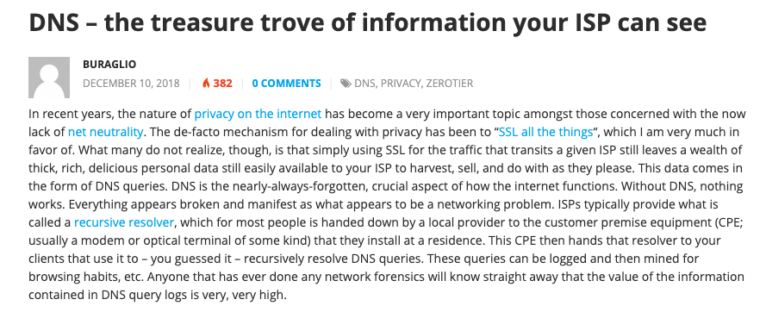
The Revenge of Carriage
Content blocking and selective damage
Active user tracking

Slide 45
Enter content providers as carriage providers…
These are the Content Delivery Networks (CDN)
They package content services with a dedicated delivery networks and want to use SKA inter-network provider arrangements to reach their customers

Slide 46
The Counter Move
Content is exploiting end-to-end encryption to hide everything
Encrypt the content (TLS)
Encrypt the meta-data of the content (ECH)
Encrypt the DNS (DoT, DoQ, DoH)
Encrypt the transport protocol (QUIC)
Encrypt the end points from each other (Oblivious services)
This pushes the carriage provider well into a commodity role, dealing in undistinguished opaque traffic

Slide 47
What are we learning?
“Sender Pays” does not improve the efficiency of the carriage infrastructure, nor does it benefit consumers
Carriage is no longer an inescapable monopoly - massively replicated content can be used as a substitute for many public carriage service elements
Structural cross-subsidies and poor regulatory responses weaken the longer-term incentives for efficient infrastructure investment

Slide 48
Thanks!

