Slide 1
LEOs and GEOs
Geoff Huston
APNIC

Slide 2
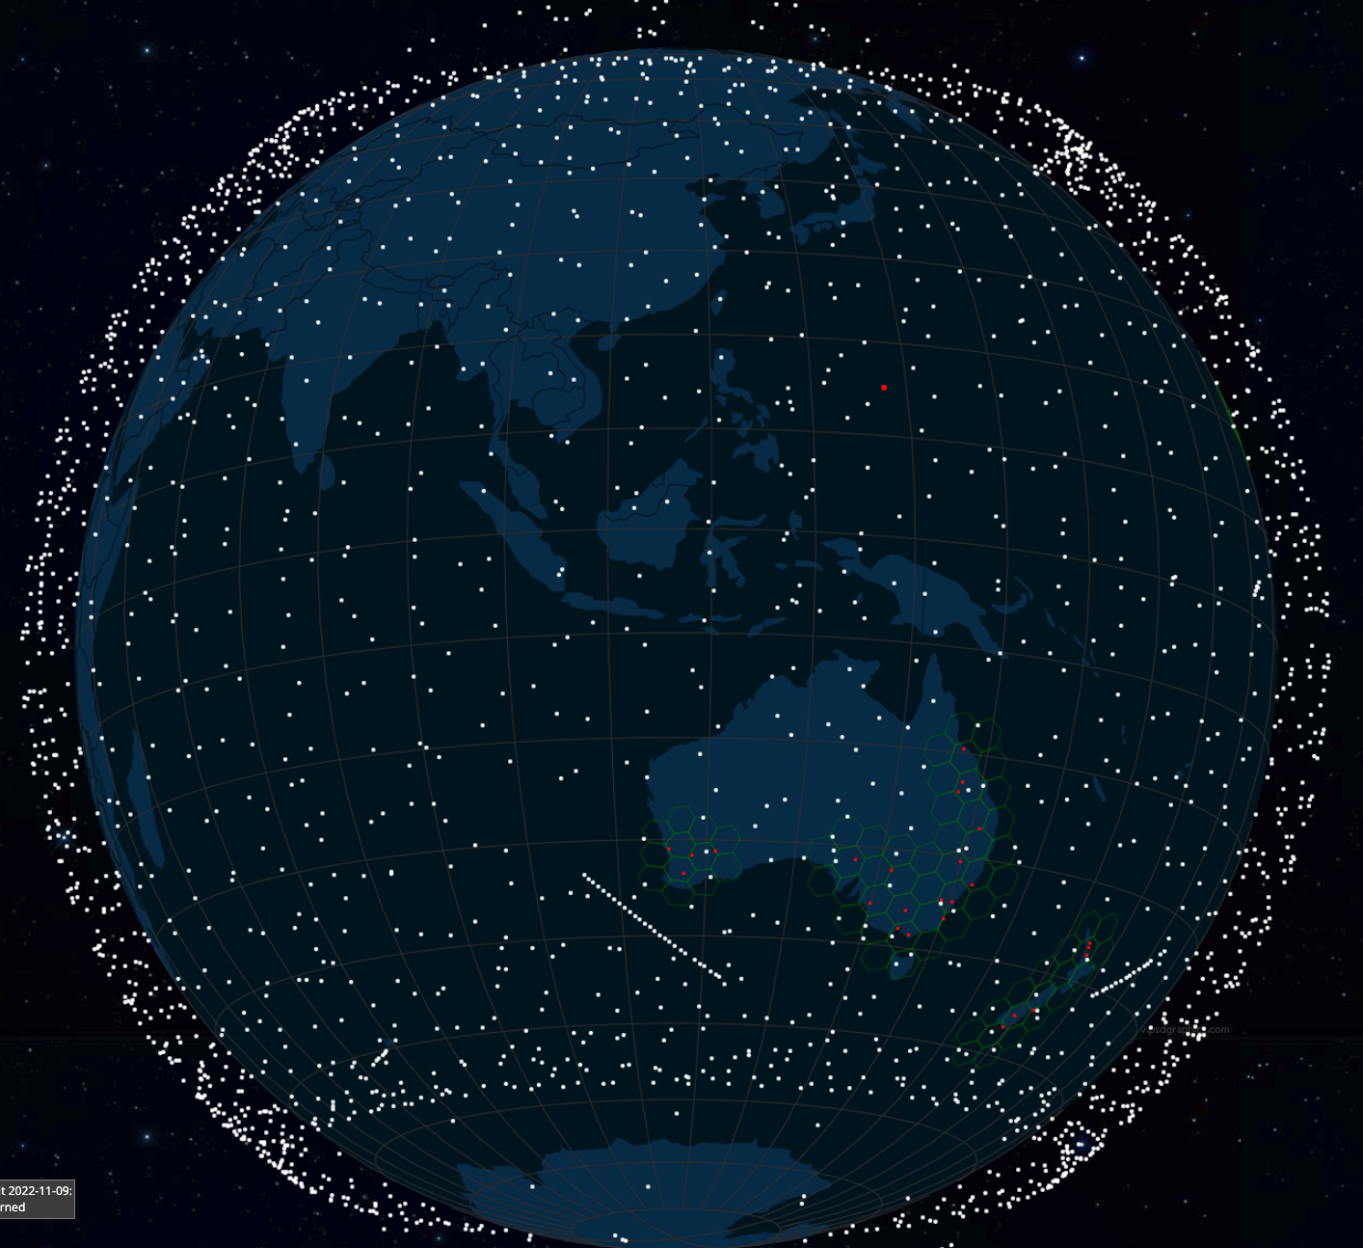
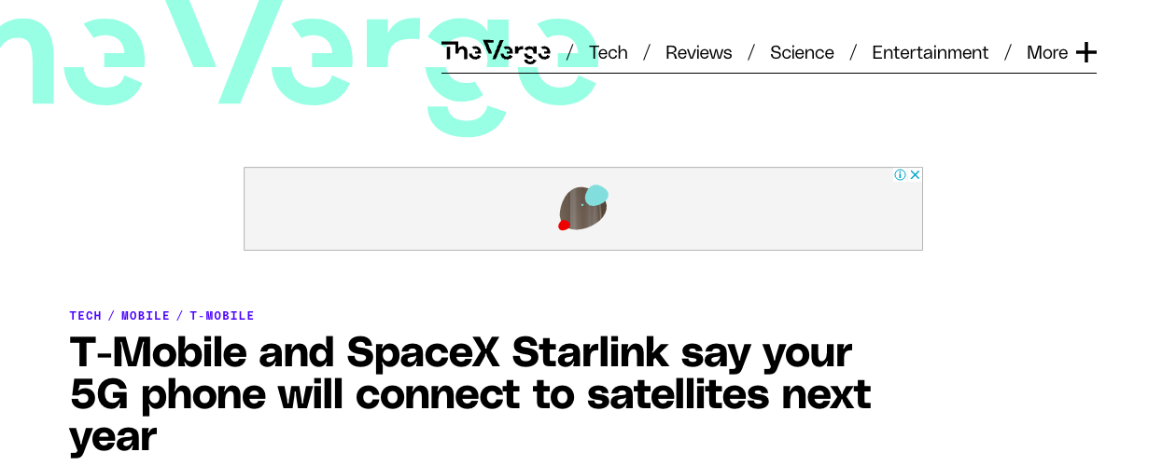
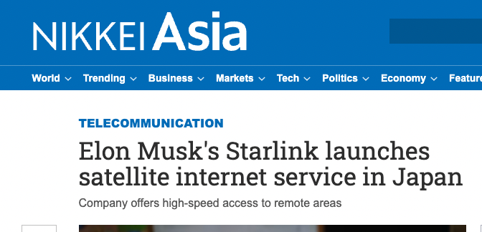
LEOs in the News
screenshot from starwatch app
Screenshot - https://www.theverge.com/2022/8/25/23320722/spacex-starlink-t-mobile-satellite-internet-mobile-messaging
Screenshot: https://asia.nikkei.com/Business/Telecommunication/Elon-Musk-s-Starlink-launches-satellite-internet-service-in-Japan

Slide 3
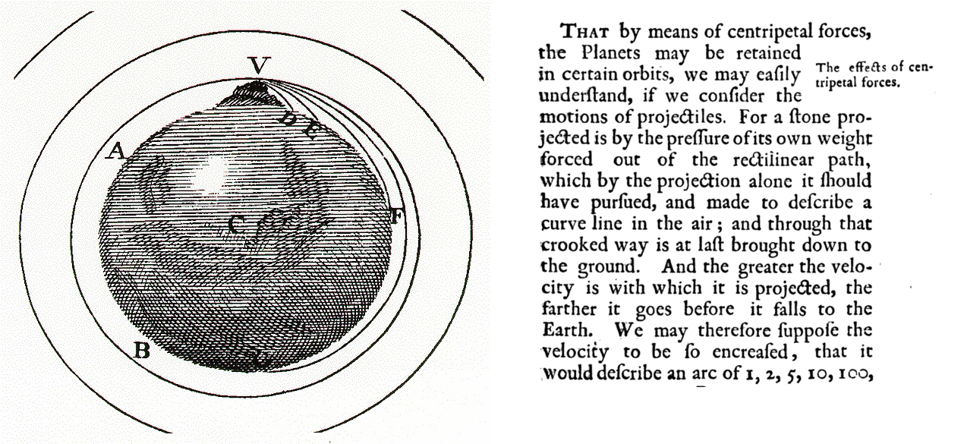
Newtonian Physics
If you fire a projectile with a speed greater than 11.2Km/sec it will not fall back to earth, and instead head away from earth never to return
On the other hand if you incline the aiming trajectory and fire it at the critical speed it will settle into an orbit around the earth
The higher the altitude the lower the orbital speed

Slide 4
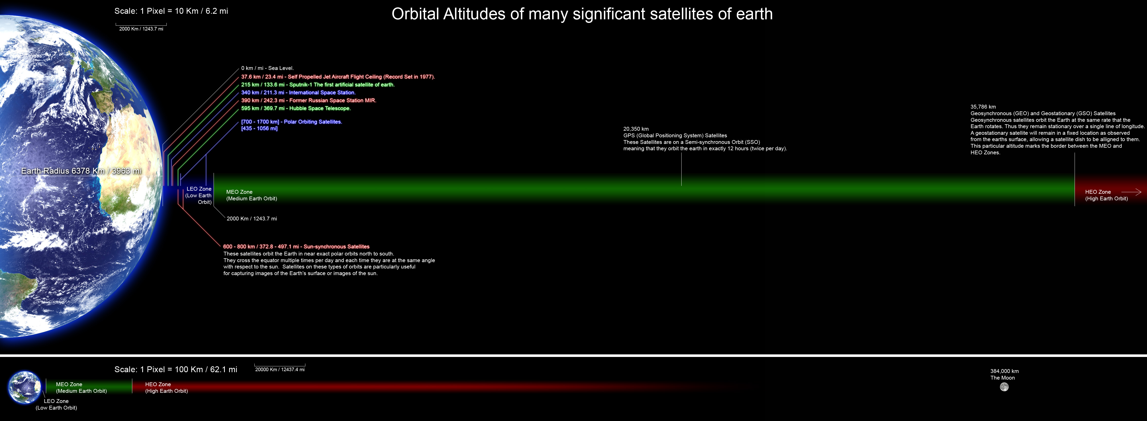
Leos
Geos
https://commons.wikimedia.org/wiki/File:Orbitalaltitudes.jpg GNU Free Documentation License

Slide 5
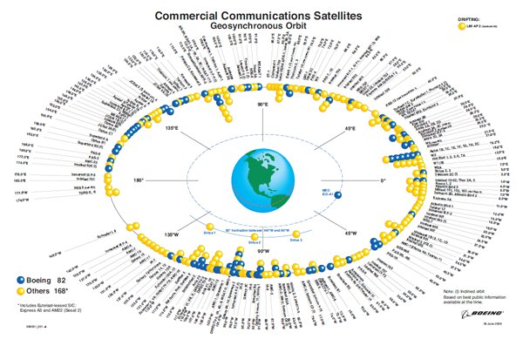
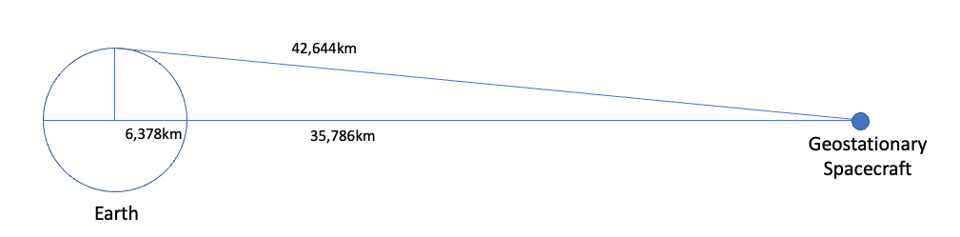
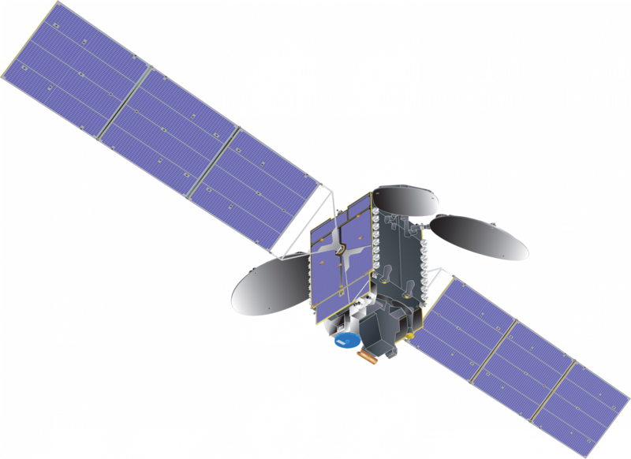
Geostationary Earth Orbit
At an altitude of 35,786km a satellite will orbit the earth with the same period as the earth’s rotation – from the earth it will appear to be stationary in the sky
https://commons.wikimedia.org/wiki/File:Communications_satellite_with_TEMPO_spacecraft_model.png – public domain
https://secure.boeingimages.com/archive/Commercial-Communications-Satellites-Orbit-2F3XC5KQCM9.html

Slide 6
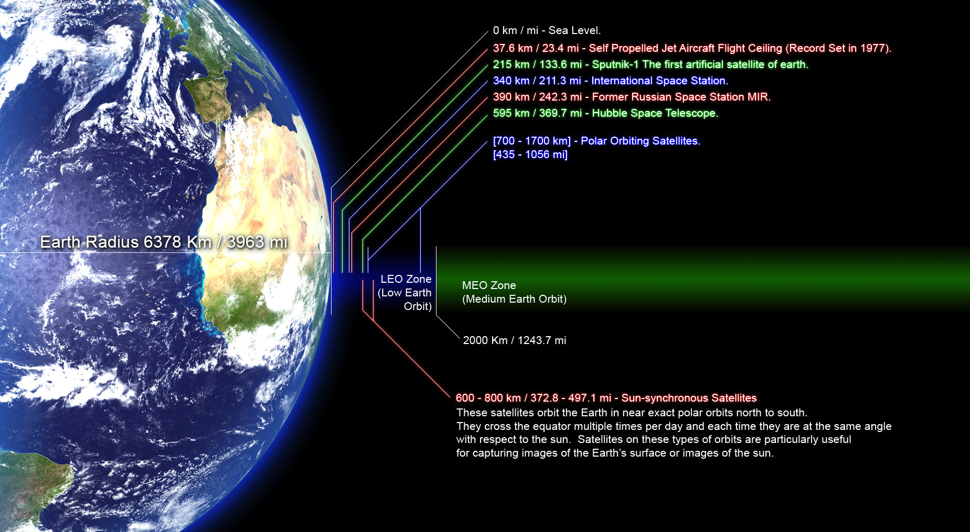
Low Earth Orbit
https://commons.wikimedia.org/wiki/File:Orbitalaltitudes.jpg GNU Free Documentation License

Slide 7
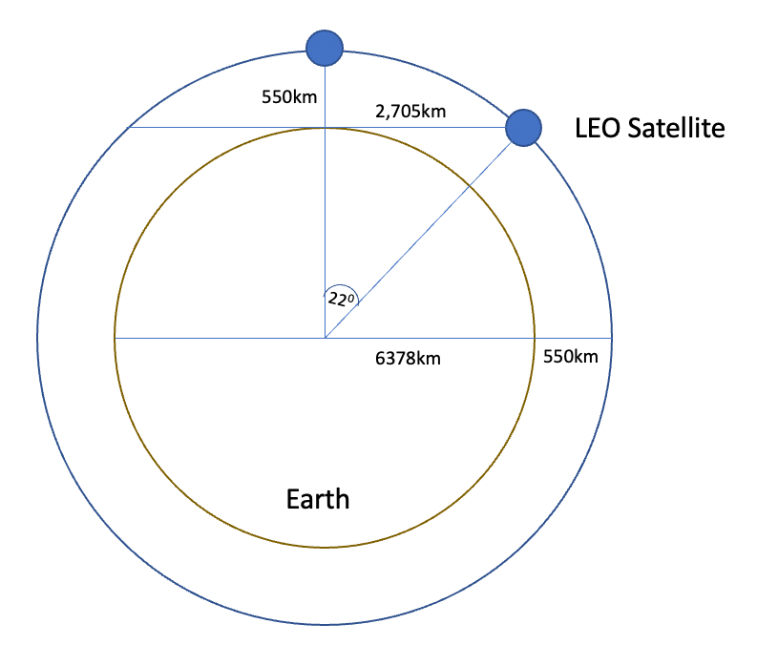
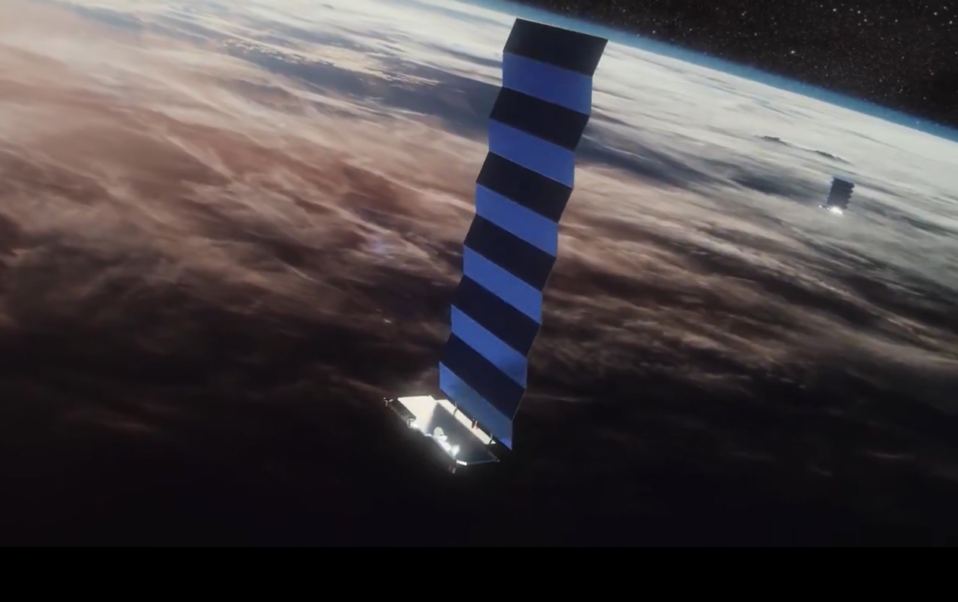
Low Earth Orbit
LEO satellites are stations between 160km and 2,000km in altitude. The objective is to keep the satellite’s orbit high enough to stop it slowing down by “grazing” the denser parts of the earth’s ionosphere, but not so high that it loses the radiation protection afforded by the Inner Van Allen belt. At a height of 550km, the minimum signal propagation delay to reach the satellite and back is 3.7ms.
Image - spacex
screenshot from starwatch app

Slide 8
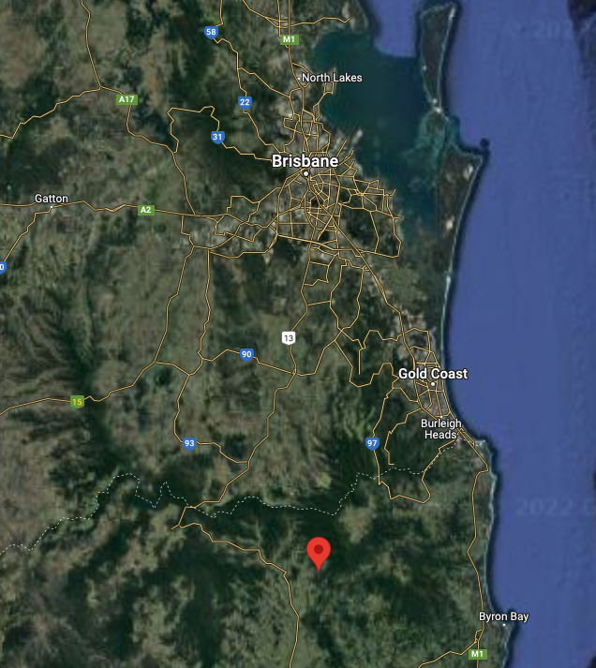
Measuring LEO and GEO services
Eastern Australia has both LEO and GEO services available
Which provided us with a unique opportunity to test the LEO and GEO services with the same endpoints
Starlink LEO service
Skymuster GEO service

Slide 9
Test Regime
We’ll use 3 different TCP congestion control algorithms: Reno, Cubic and BBR
We’ll compare three different access regimes: fibre, GEO (AUSsat) and LEO (Starlink)
We used an Intel NUC running Debian 10, and iperf3 to load the circuits

Slide 10
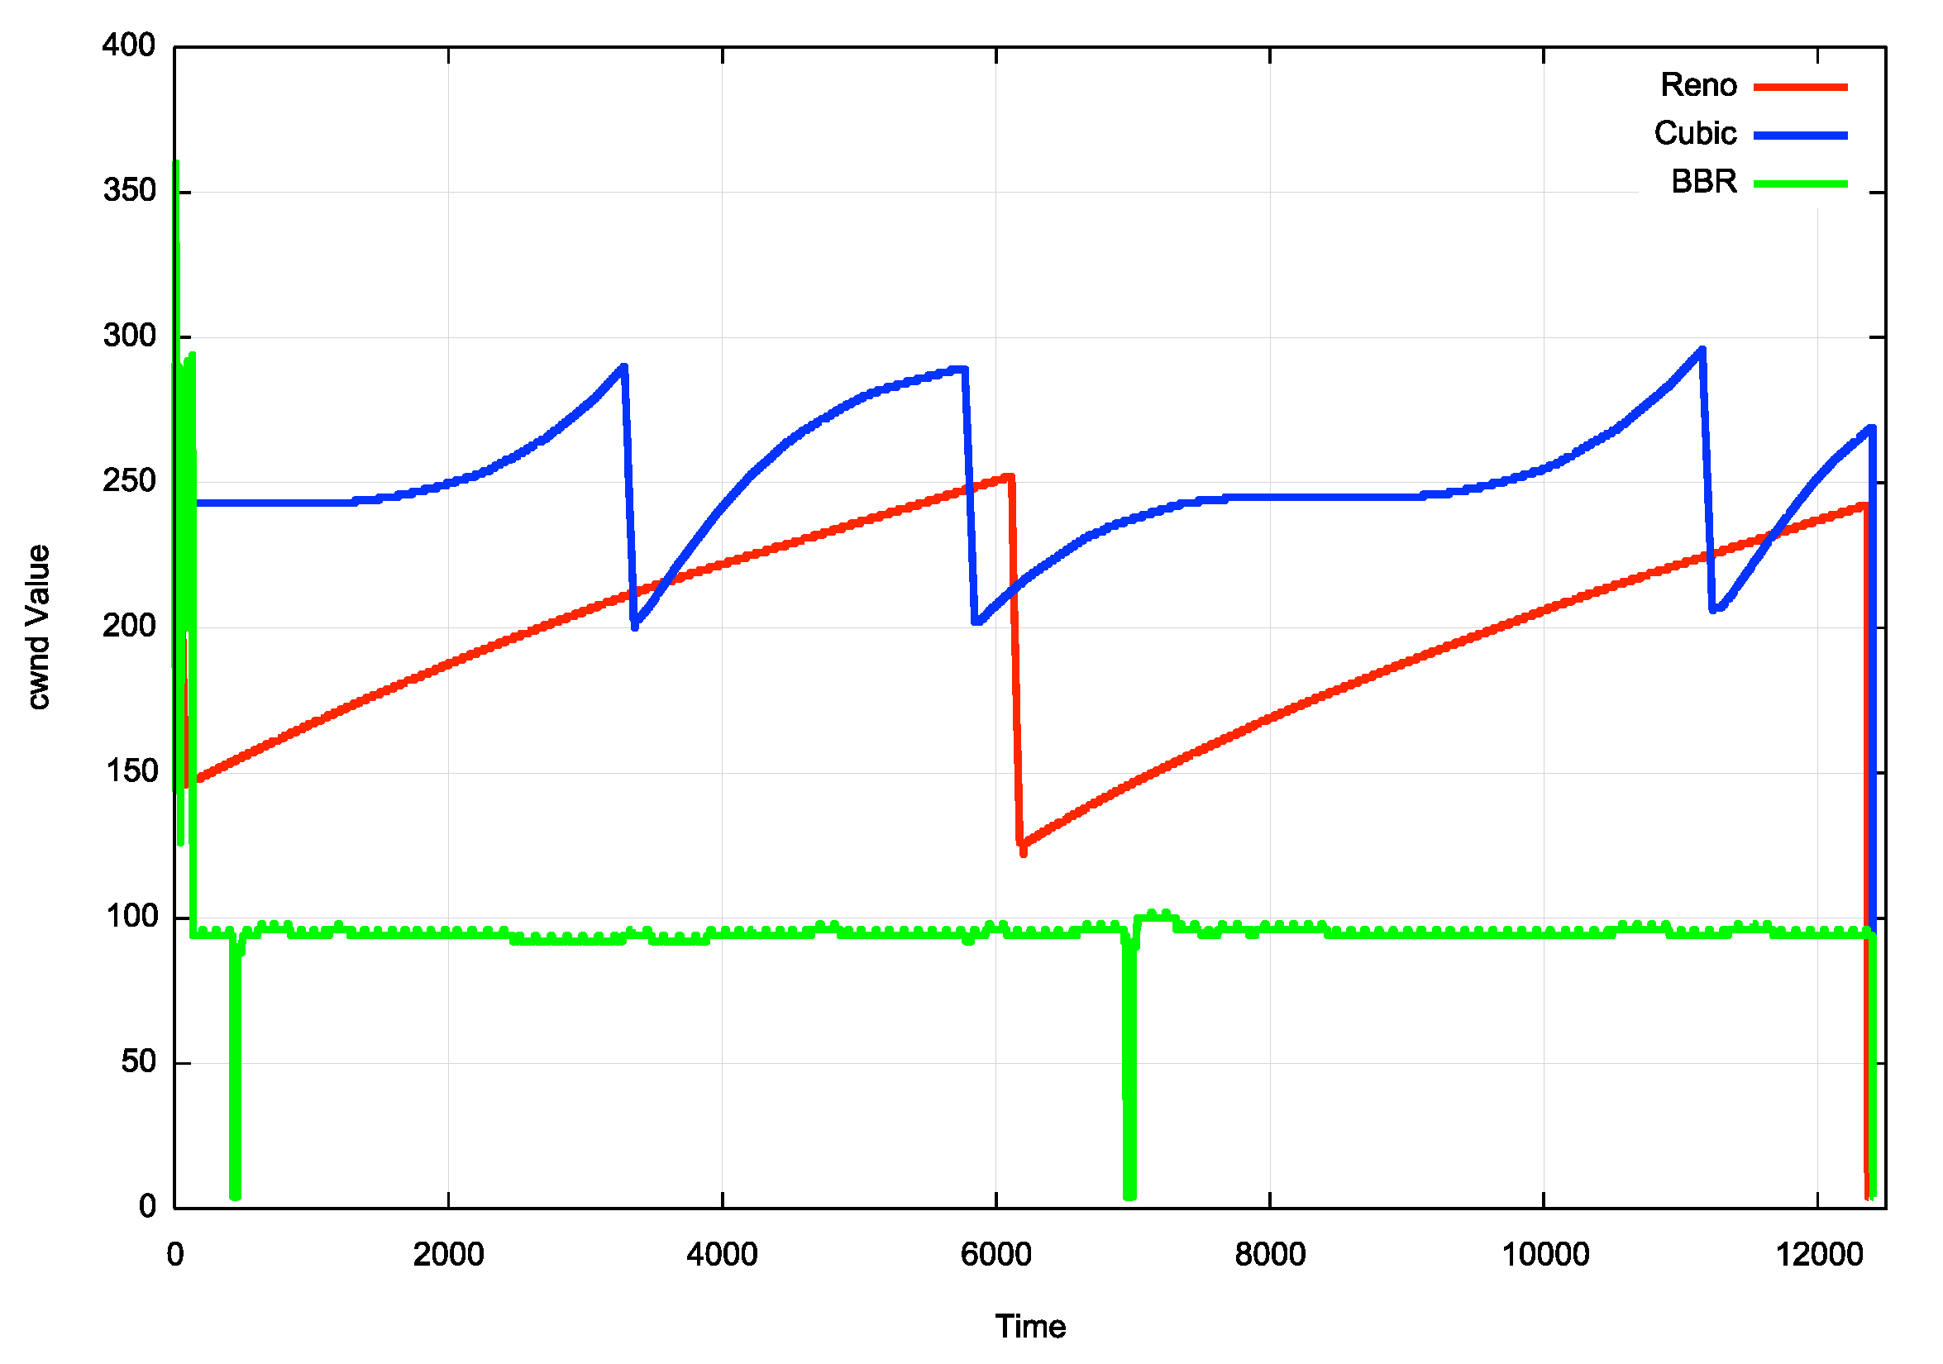
Flow Control Algorithms

Slide 11
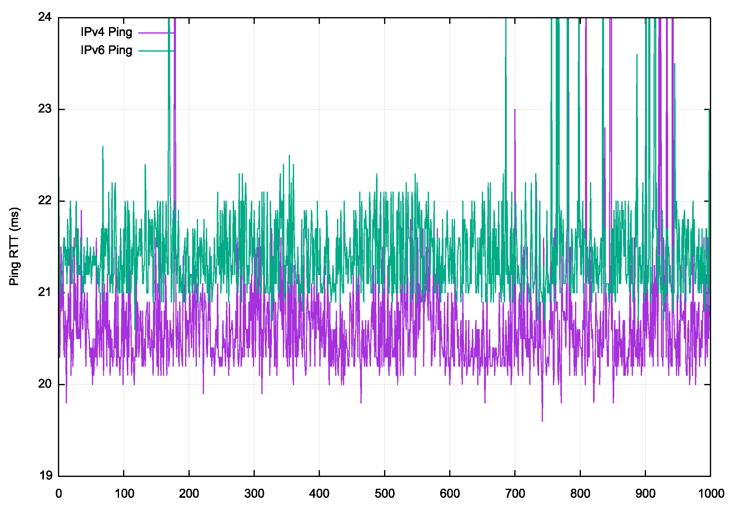
Terrestrial Fibre
Australian NBN FTTP service with a 275/25 Mbps access rate
Server and client are some 1,000km apart
Ping test:
IPv6 average 21.5ms
IPv4 average 20.5ms

Slide 12
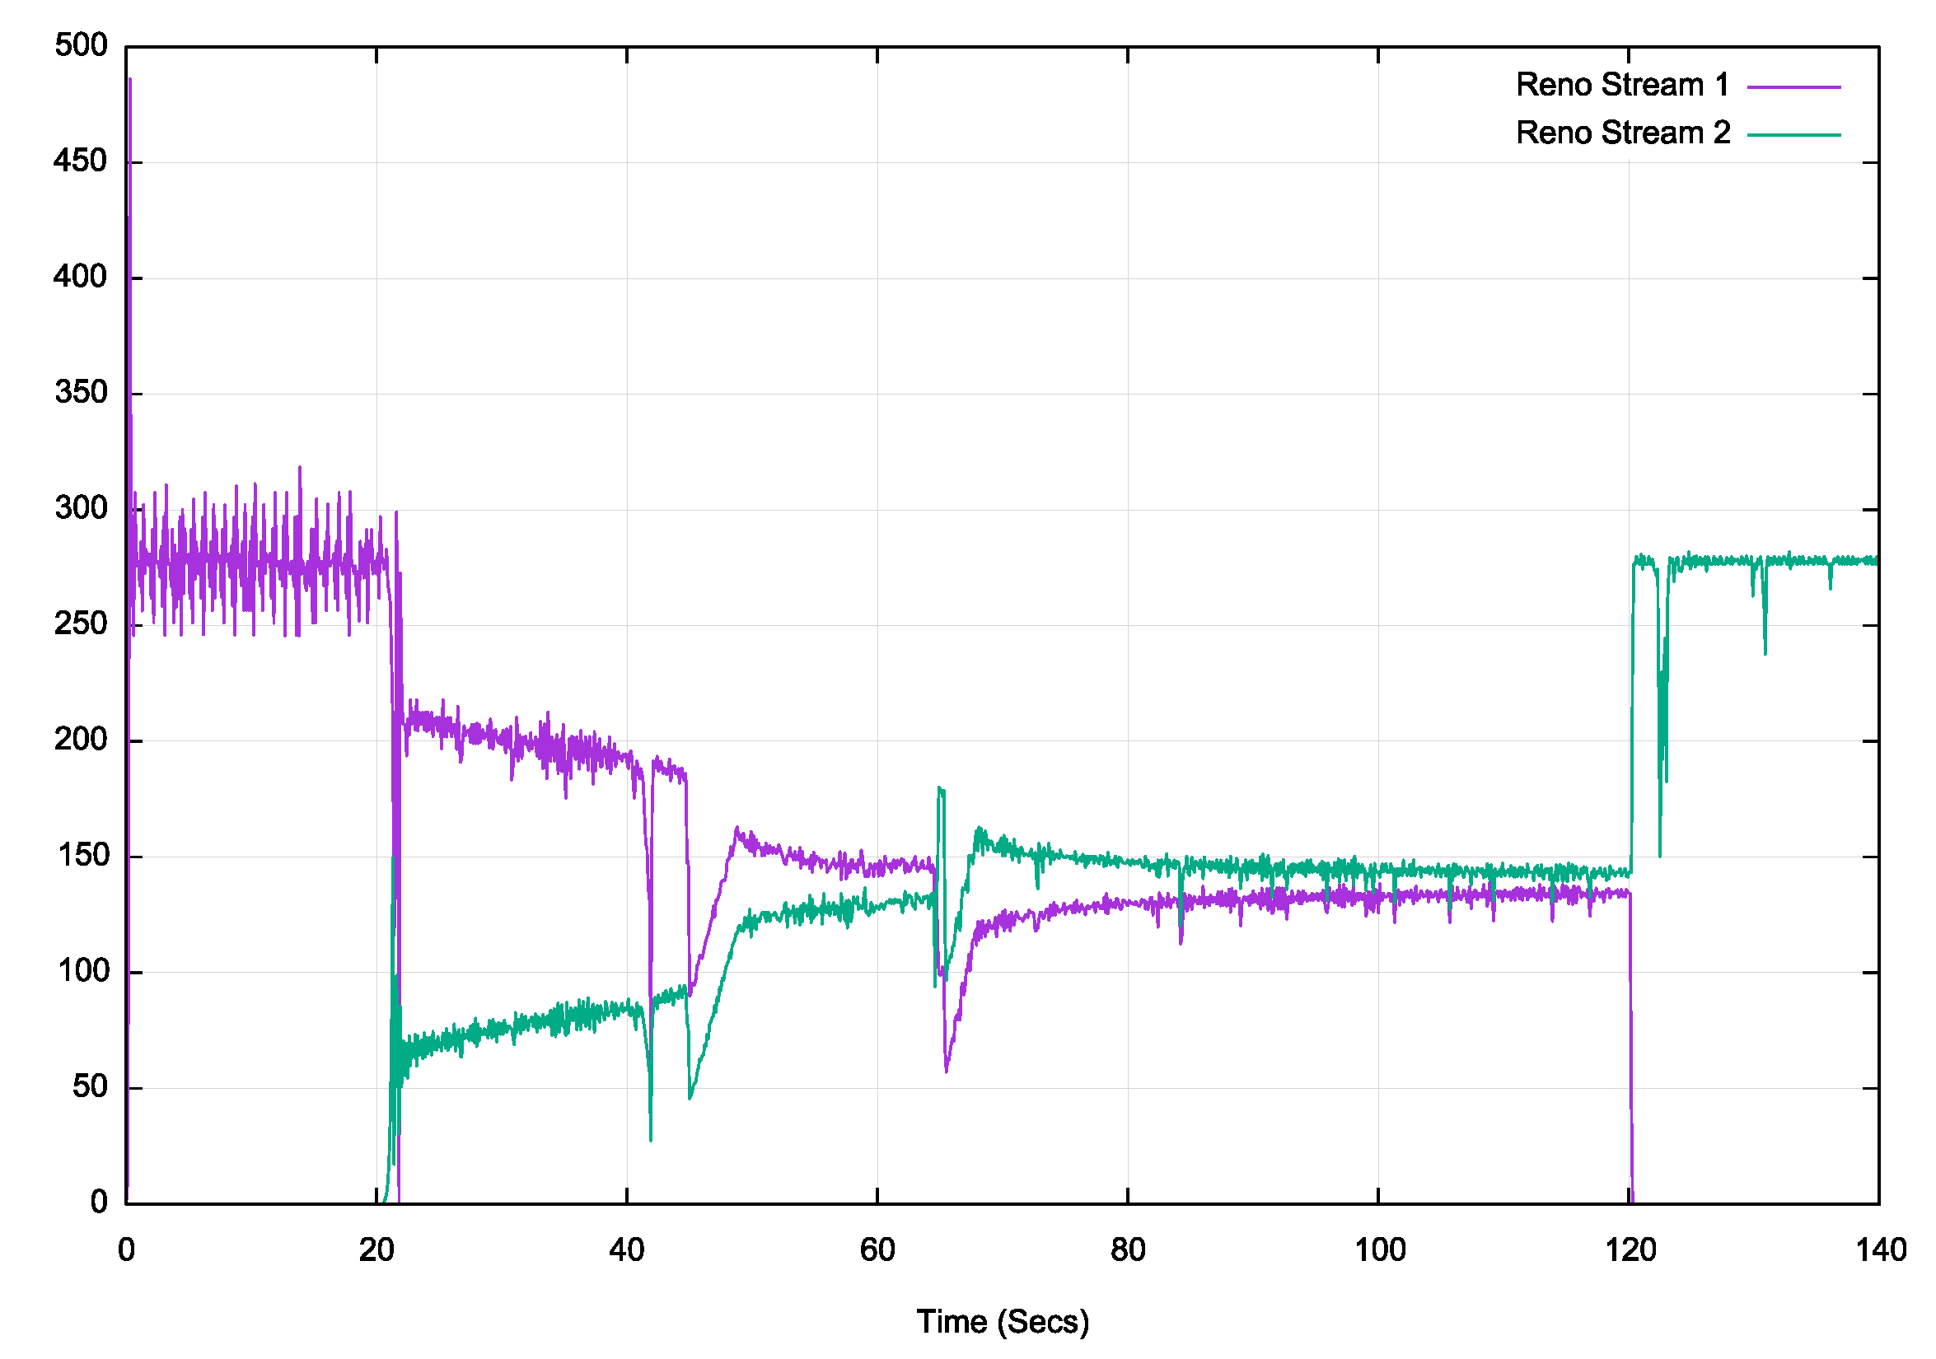
Fibre – 2 Stream Reno
Data Rate (MBPS)

Slide 13
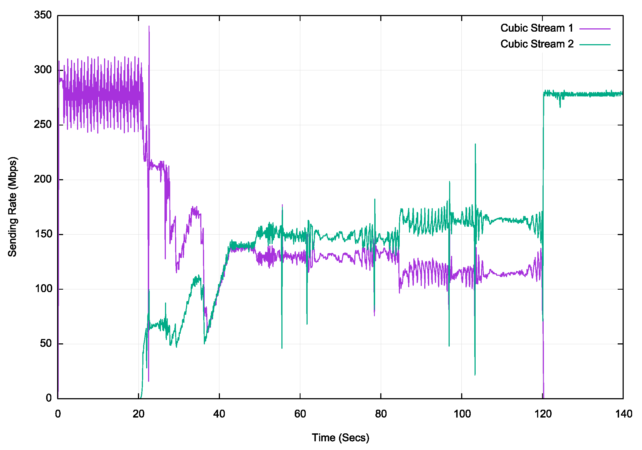
Fibre – 2 Stream Cubic

Slide 14
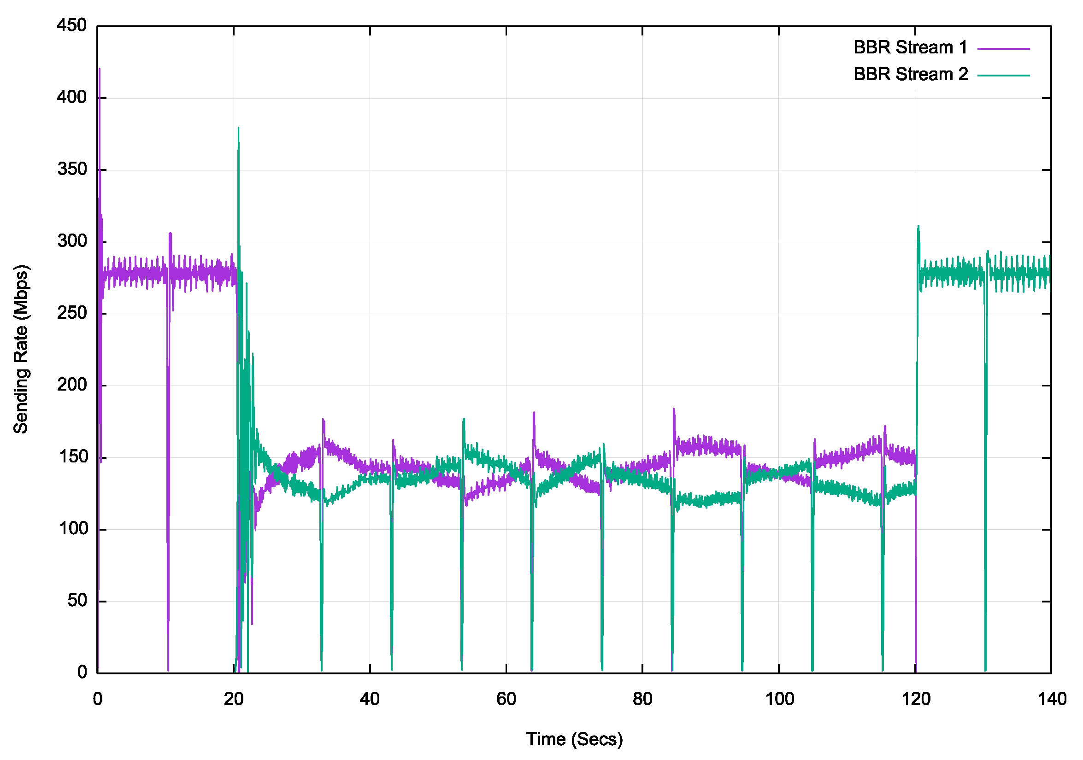
Fibre – 2 Stream BBR

Slide 15
Protocol Performance over Fibre
All three congestion control algorithms are “well behaved” in this simple test
Reno and BBR equilibrate to a 50/50 share when 2 sessions are active, while Cubic stabilises at a 60/40 split
BBR operates with very small queue pressure, and stabilises at wire speed very quickly

Slide 16
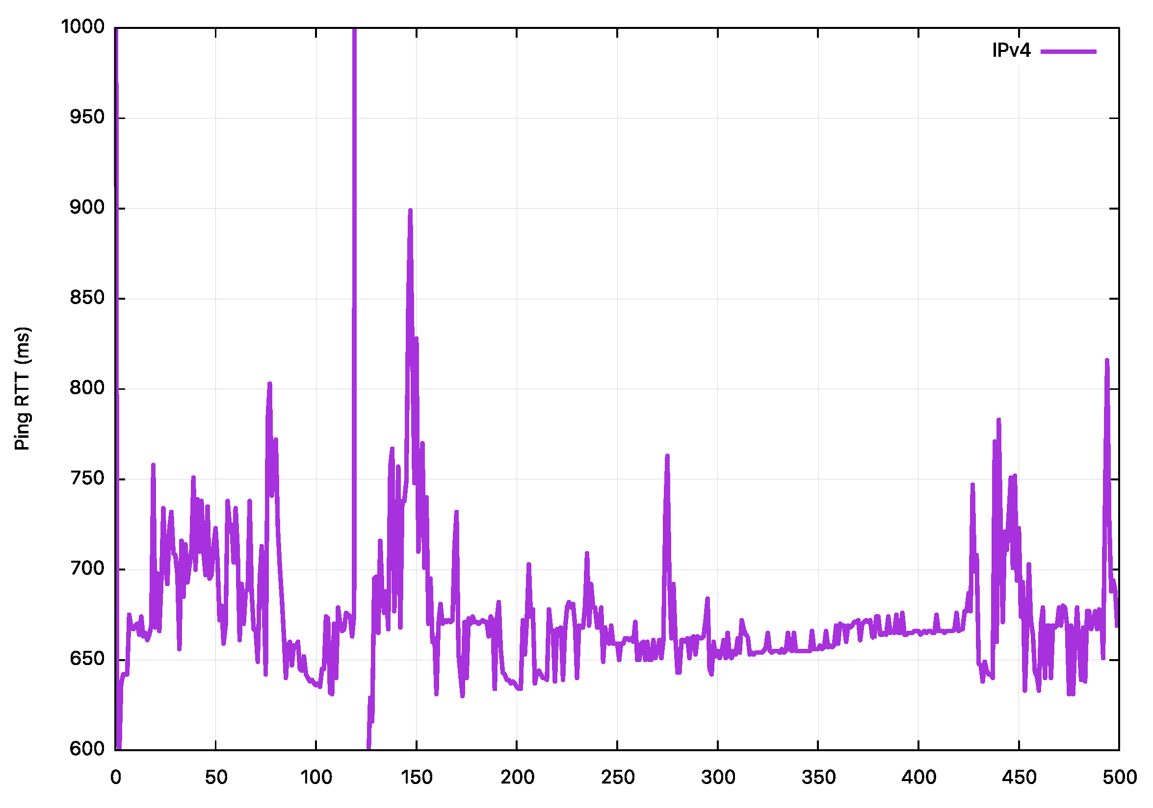
GEO Service – sold as a 45Mbps service
Ping profile

Slide 17
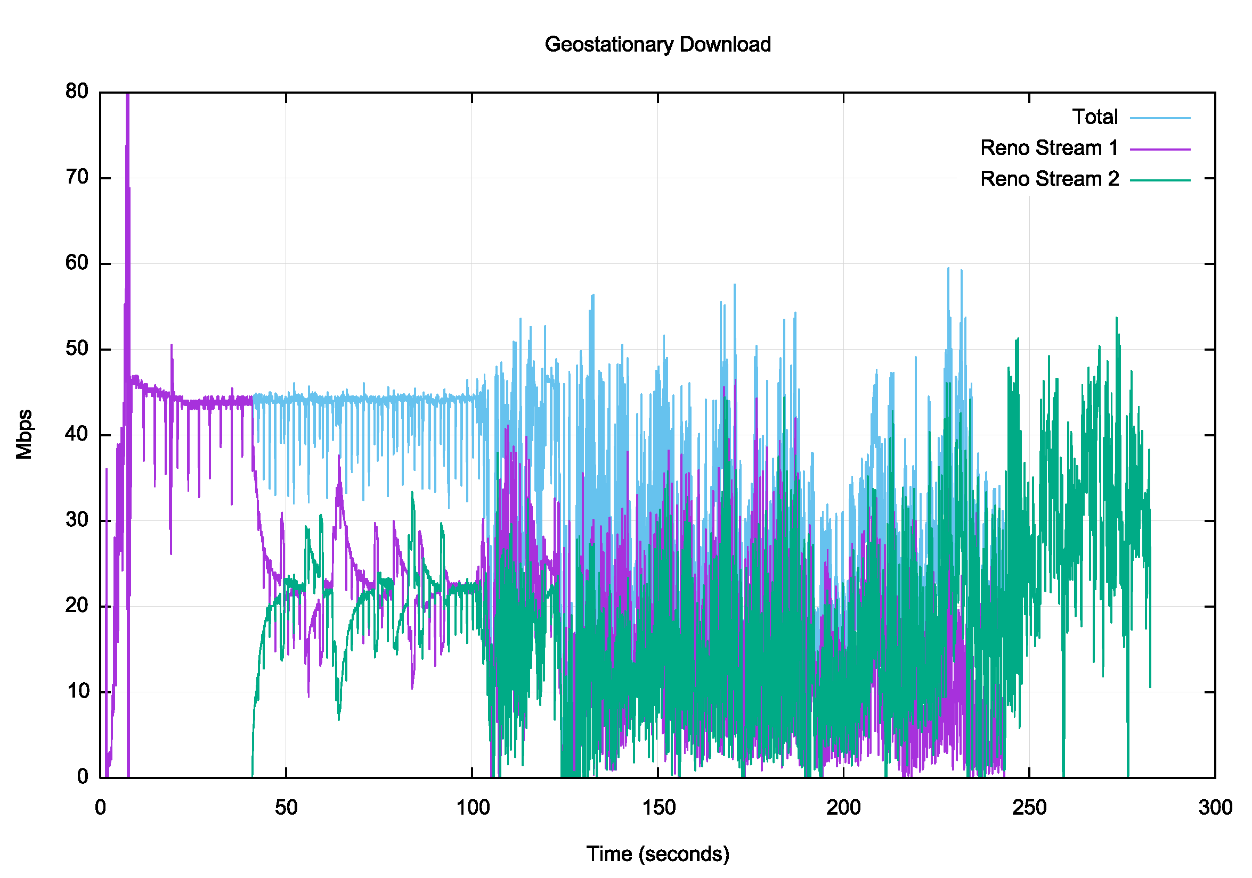
GEO – 2 Stream Reno

Slide 18
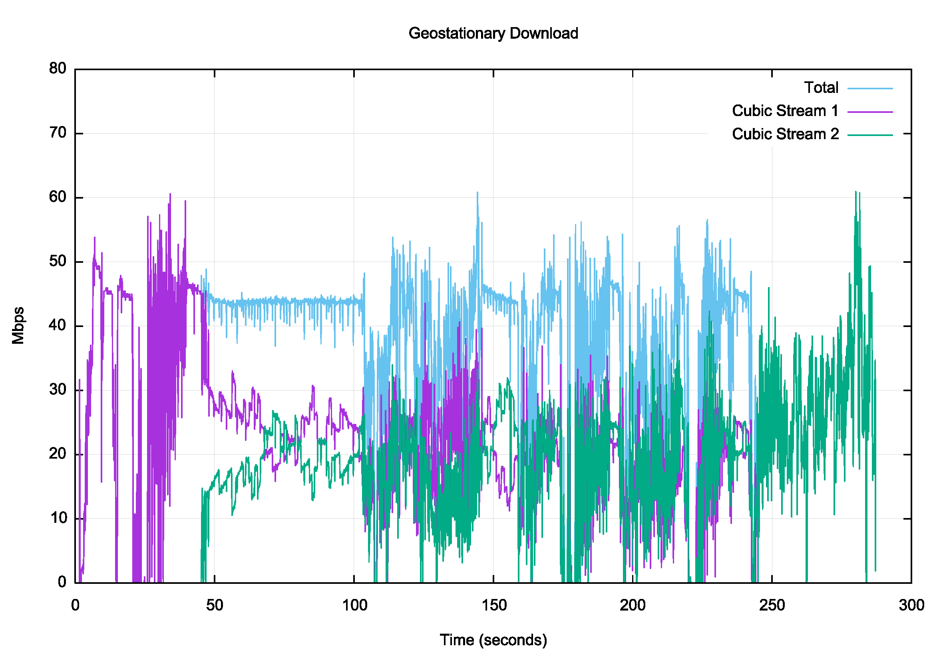
GEO – 2 Stream Cubic

Slide 19
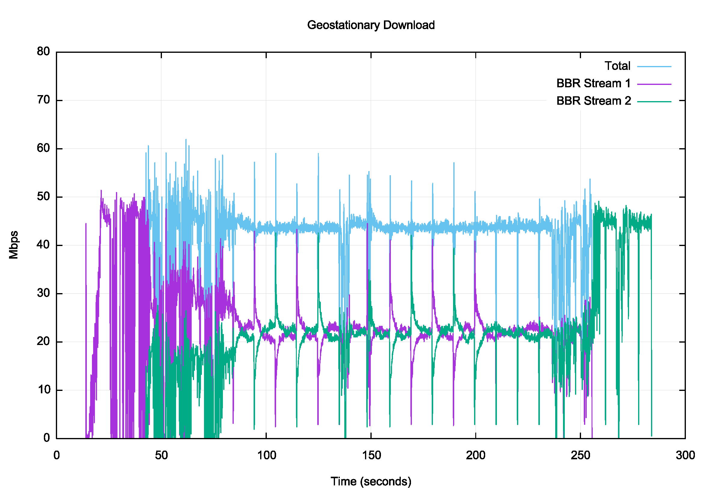
GEO – 2 Stream BBR

Slide 20
Protocol Performance over a GEO circuit
While the ping times are relatively stable, the extended RTT time pushes the congestion protocol into areas of instability – this is likely due to the presence of deep queues in this product, in conjunction with the high delay of the path
Both Reno and Cubic drop into instability after some 60 seconds. It is unclear whether this is protocol breakdown, or the impact of cross traffic on the tested flows within the GEO system
BBR operates remarkably efficiently across this system, driving the link to the delivered capacity without the build up of a standing queue - clearly BBR out-performs Reno and Cubic in this context

Slide 21
Would a TCP accelerator help when using a GEO service?
Yes and No!

Slide 22
Would a TCP accelerator help when using a GEO service?
Yes and No!
If the sender has insufficient internal buffer space to store a delay x bandwidth product of data in its local store then the sender will be buffer-limited when sending bulk data – in this case the addition of a network unit that essentially provides additional buffer space will help
But if the sender has sufficient local buffer space than the network unit will have no effect

Slide 23
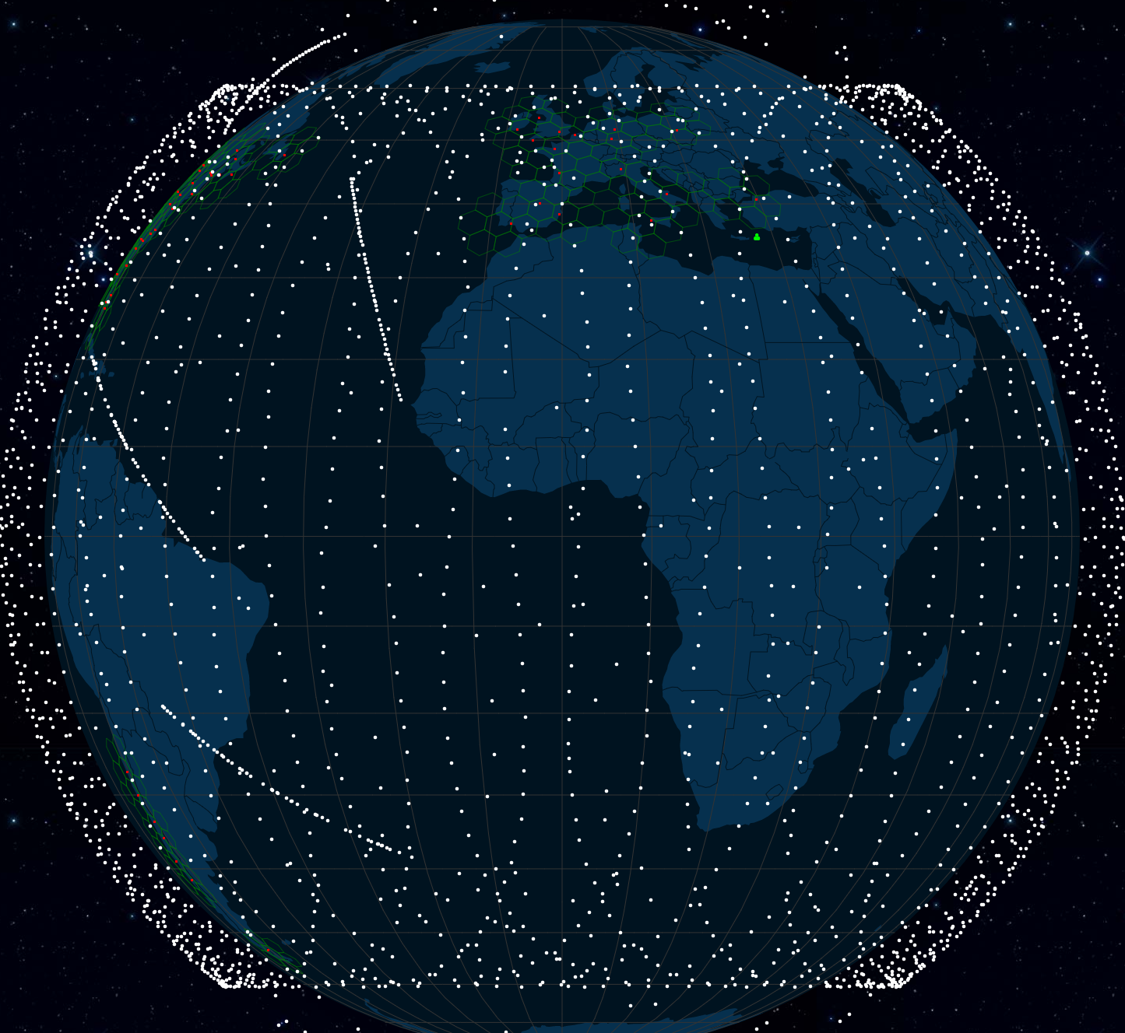
Starlink LEO service
https://satellitemap.space/

Slide 24
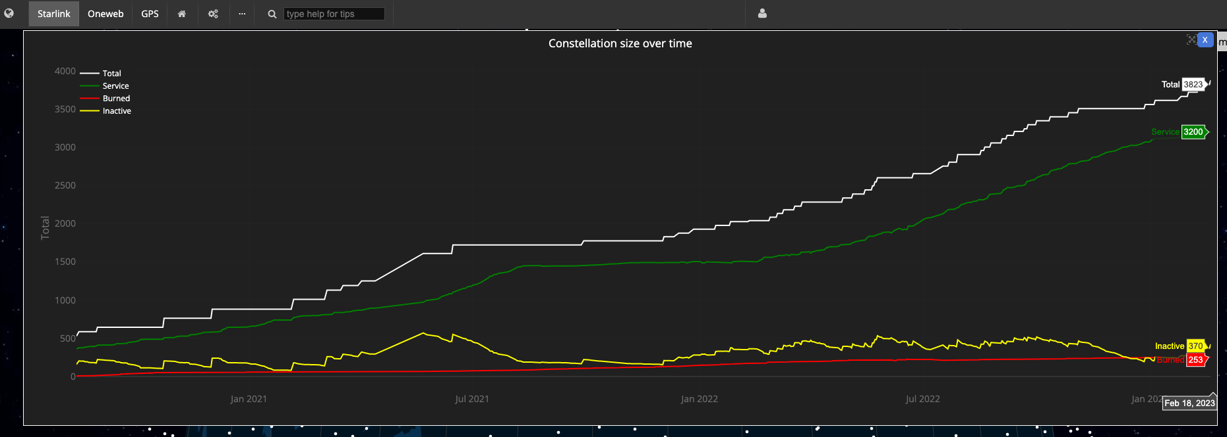
Starlink LEO service
3,200 in-service operational spacecraft, operating at an altitude of 550km
https://satellitemap.space/

Slide 25
Starlink LEO service
3,200 operational spacecraft, operating at an altitude of 550km
One-way signal propagation time to reach the spacecraft varies between 1.8ms and 3.6ms (equivalent RTT of 7.3ms to 14.6ms)
But that’s not what we see:
2000 packets transmitted, 1991 received, 0.45% packet loss, time 2009903ms rtt min/avg/max/mdev = 37.284/60.560/214.301/13.549 ms

Slide 26
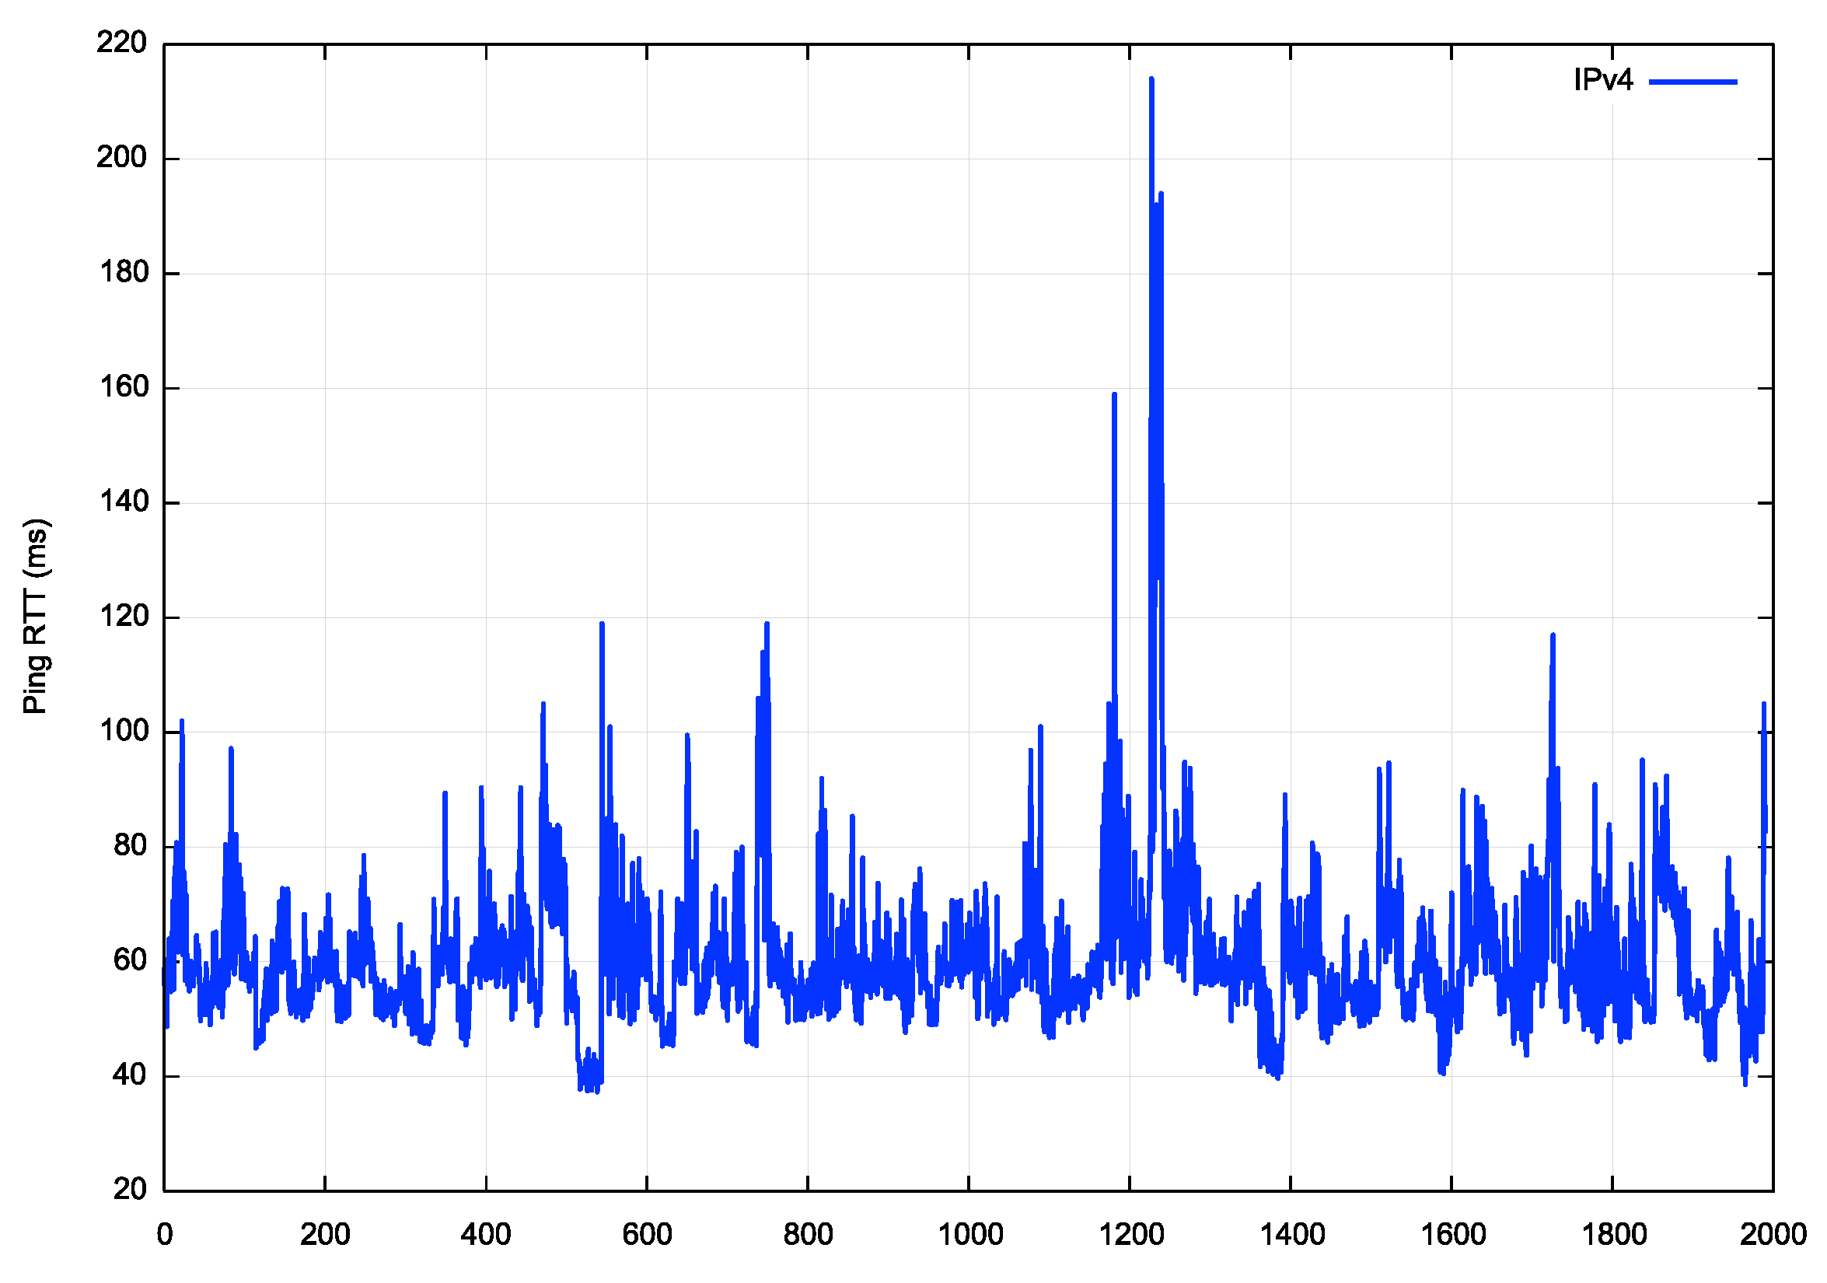
Starlink RTT Ping Times
We are seeing:
12ms terrestrial component,
7ms/14ms propagation component,
30ms for codec/fec/switching

Slide 27
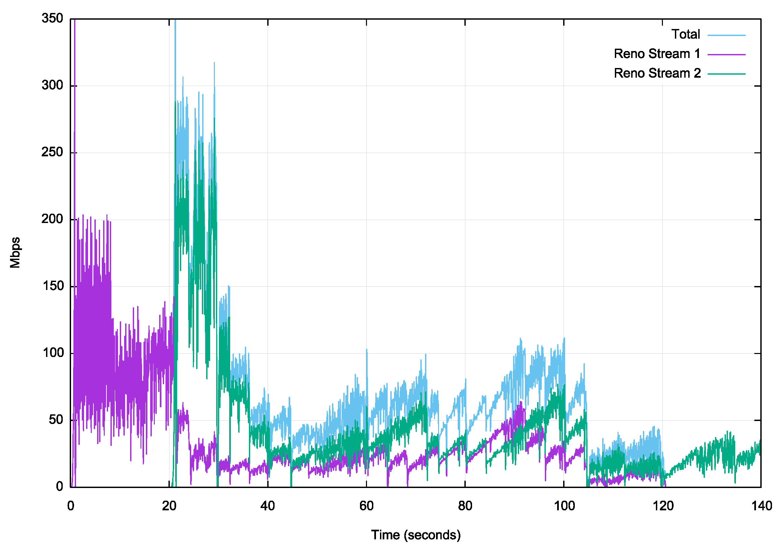
Starlink – 2 Stream Reno
Relatively unimpressive performance.
There appears to be imposed packet loss events that hampers Reno inflating the sending rate

Slide 28
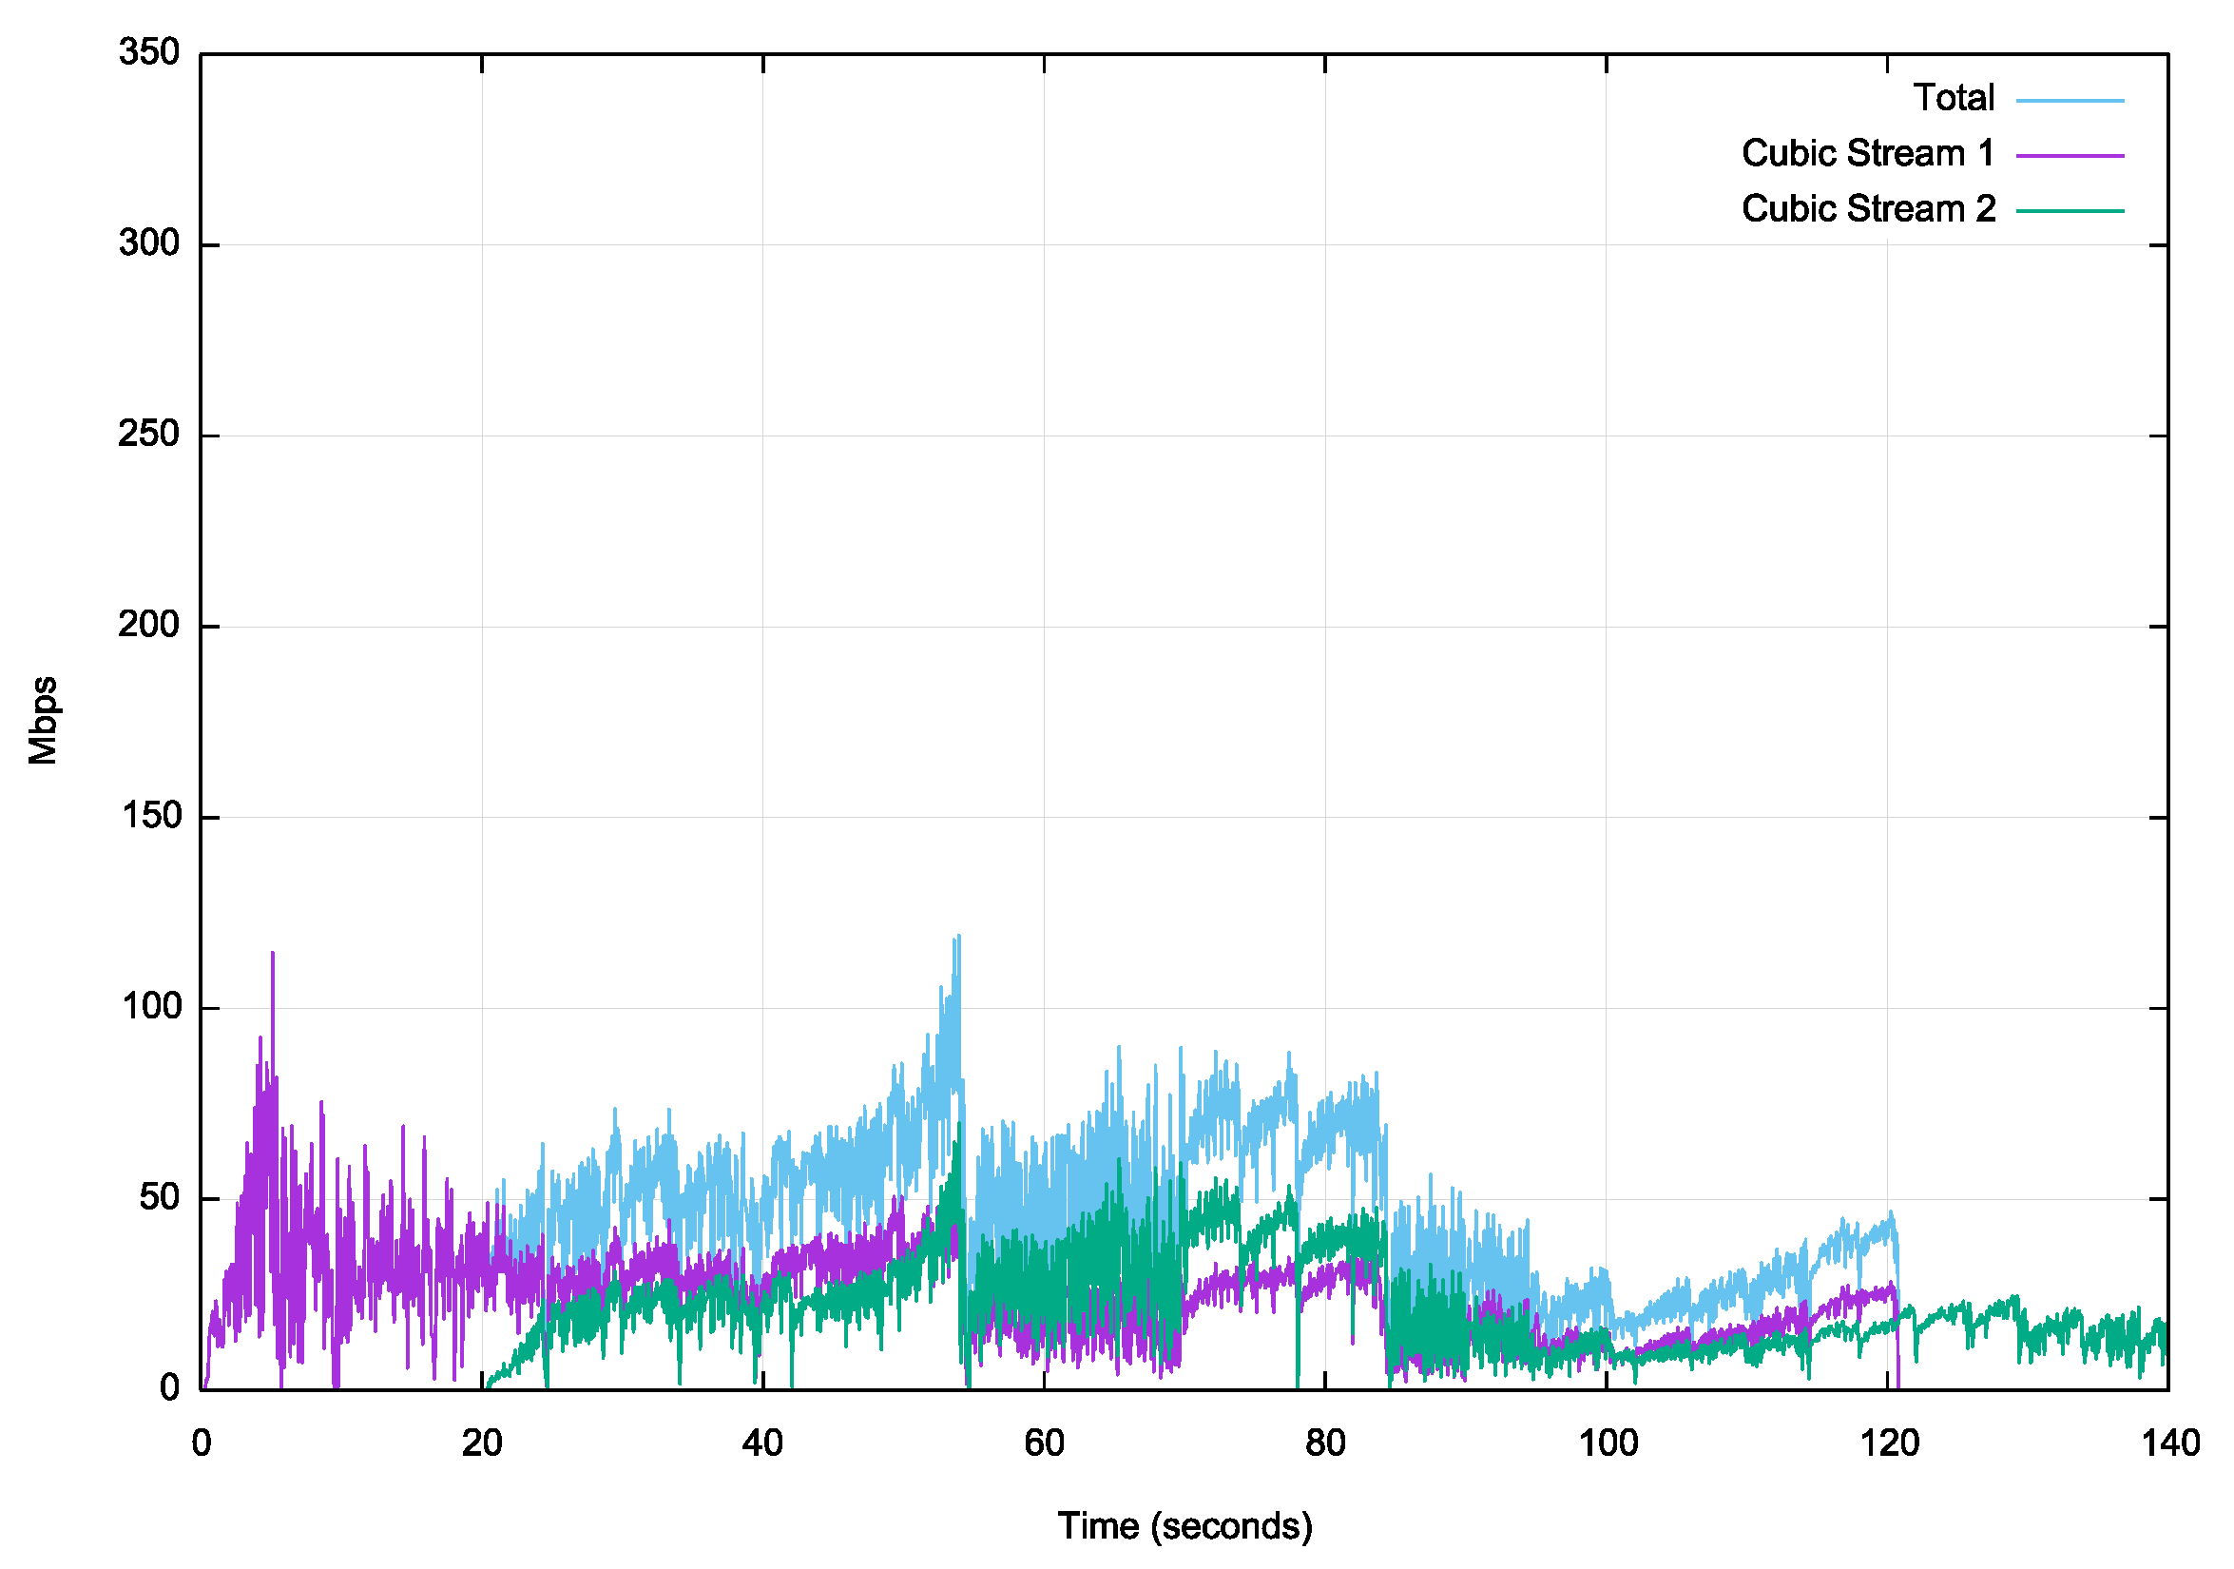
Starlink – 2 Stream Cubic
Also unimpressive performance.
Cubic appears to be more stable than Reno, but still fails to open up its sending rate over time, so the higher stability is achieved at a cost of lower overall throughput

Slide 29
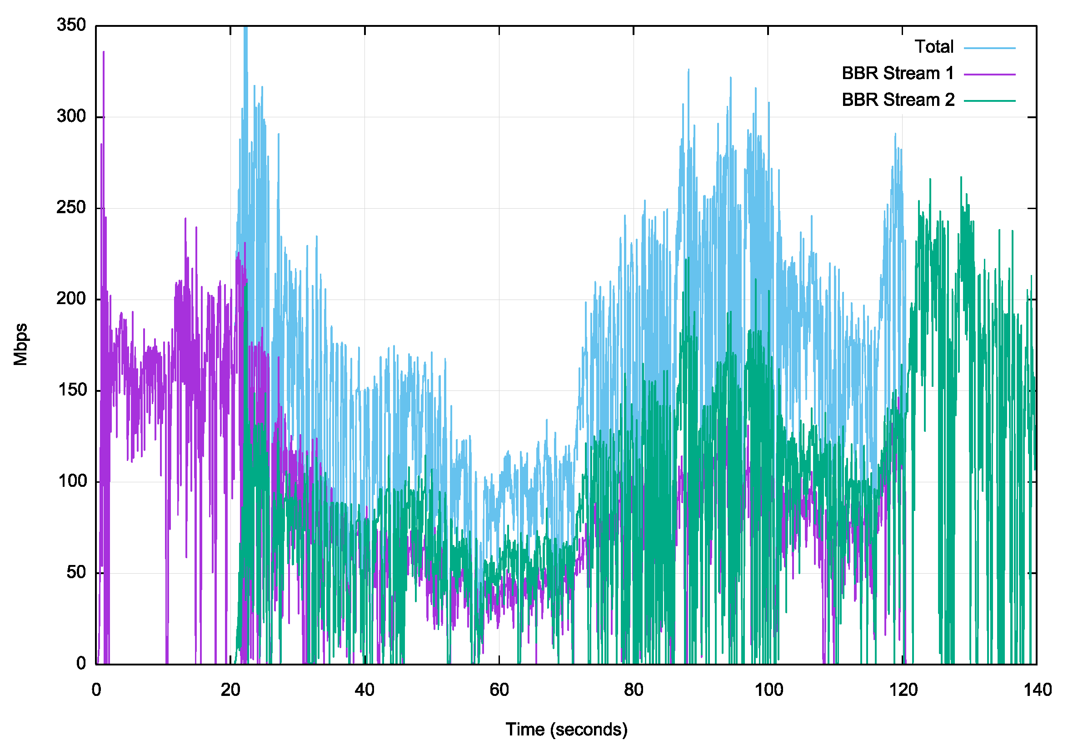
Starlink – 2 Stream BBR
BBR seems to be better positioned to extract performance from a variable platform in loss and jitter terms- it is able to operate 3 – 5 times the speed of Cubic or Reno between the same endpoints
The packet loss rate is higher than expected, and this may be an outcome of the combination of using phase array antennae that are tracking satellites that are moving through the sky at a relative speed of 1 degree of elevation every 15 seconds, together with the need to perform satellite handover at regular intervals.

Slide 30
Observations from this data
LEO services should clearly out-perform a GEO service – but the results are not so clearly differentiated
The GEO services appear to operate with a highly level of stability which tend to allow the loss-based TCP protocols to operate efficiently even with the extended delay
The LEO services have a far more responsive feedback loop due to the lower RTT
BBR is still clearly a better flow algorithm than loss-based TCP in this space: this applies to Fibre, LEO and GEO!
Don’t throw away your terrestrial fibre!
Capacity, stability and protocol performance on fibre-based system are clearly better than satellite paths, if they are available and suit your needs

Slide 31
More measurements needed …
Is iperf3 on Linux the right measurement tool?
Can we bypass the Linux kernel baggage and measure the ‘raw’ TCP protocol performance?
Would using QUIC provide a different view of protocol performance?
How do LEO services compare to 5G?
Speed vs stability?
Should a LEO service expose the underlying jitter and loss to the application, or should it integrate smoothing, and even basic retranmission into the service at the cost of a higher delay overhead?

Slide 32
Does it scale?
Fibre – well yes, just bury more cable!
Geo – not really
Geostationary spacecraft are normally separated by 2 – 3 degrees or arc, so there are some 120 – 180 viable slots. The radio frequencies are also limited to the C, Ku and Ka bands. The on-craft transponders are not steerable so the capacity is provided to a pre-designed footprint
Leo – unclear, but probably not
LEO constellations use low altitude eccentric orbits so the number of space craft in a constellation is determined by the inter-craft distance, horizontally and vertically.
Starlink plan for 12,000 craft, Kuiper (Amazon) place for 3,200, Telesat 188, IRTU filings indicate China is planning a constellation with 13,000 craft
There is an issue with space junk at LEO orbits. Any collision will generate more junk, and the risk of a runaway effect is high if the altitude slots are densely packed

Slide 33
What about Starlink V2?
These satellites are larger, heavier and operate at a higher power level
More bandwidth available, and high achievable data speeds
Incorporate 5G cellular services
Intended to use inter-satellite laser connectors to support packet routing across satellites – details sparse so far

Slide 34
Questions?

